Slide 1

Start the journey to Internet of Things with Arduino
Pradeep Bhatter
@Pbhatter, pbhatter@yahoo.com
Notes:
Introduction
Kids: Grade level, Programming experience, Electric & Electronic circuits
https://www.youtube.com/watch?v=VQj71FWk1FA Harold Robins Help!
https://www.youtube.com/watch?v=PdBvBtdbQpw 3 Stoogies
https://www.youtube.com/watch?v=l-gQLqv9f4o pep talk

Slide 2
Ground rules
Participate and enjoy; Share, work as a team.
Be Safe!
Getting attention: If your team needs help, make the red cup visible. Otherwise keep the green cup visible.
This is a work area! People are working. Please do not disturb them.
Use the kits carefully and re-assemble it back at the end of the workshop. Other teams will use them.
One parent can help the team, if needed.
Rest rooms are by the break room.
Notes:
Kits used today will be sold after the afternoon session at cost.

Slide 3
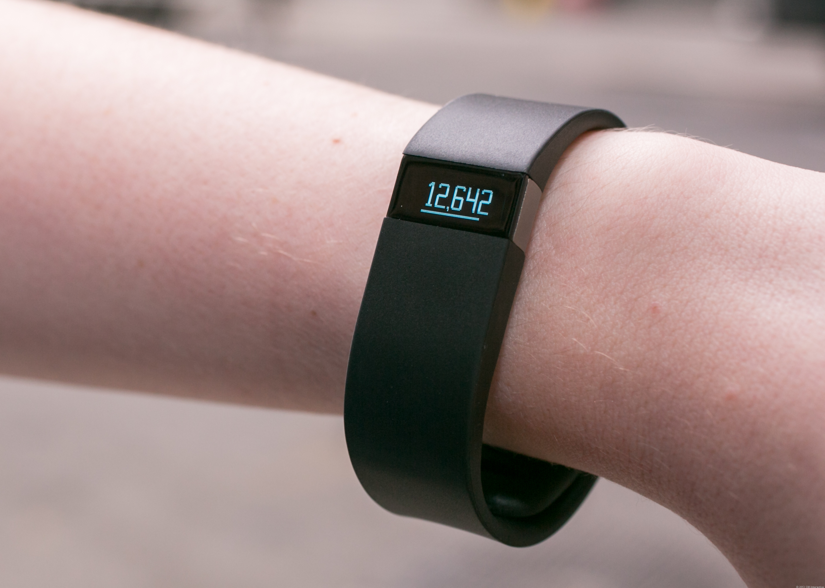
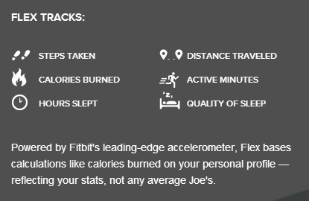
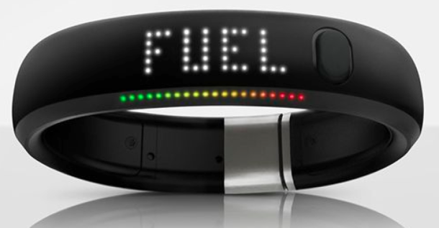
New gadgets ….

Slide 4
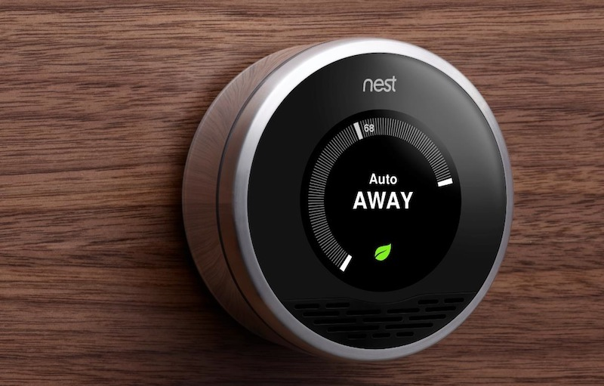
New gadgets ….

Slide 5

Have you seen this one ….

Slide 6

Joining hands …
Internet of Things
Sensors
Controllers
Wireless &
Network
Apps
Mobile devices
Cloud

Slide 7
What are we going to do today?
Use electricity to sense and change the world around us.
Connect sensors and actuators to controller (Arduino) and make “Things”
Write instructions for Arduino to provide “behavior” to “Things”
Communicate with “Things” over network

Slide 8
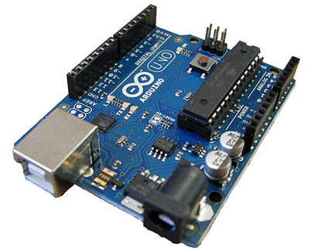
I am Arduino!
나는 아두 이노입니다
मैं अरदुनओ हूँ
我的Arduino!
Ik ben Arduino!
Sono Arduino!
Je suis Arduino

Slide 9
Activity #1
Build a light with a switch you push to turn it on (Just like the one for door-bell)
Try with the Latch (an On-Off switch, just like one for light)
Notes:
00:10

Slide 10
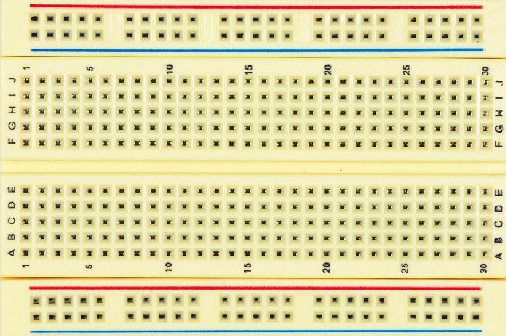
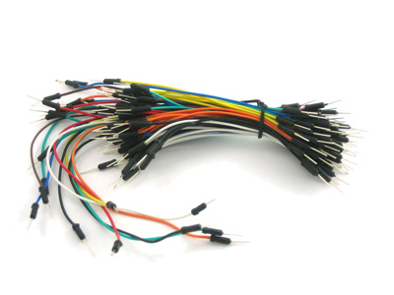
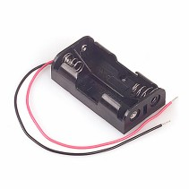
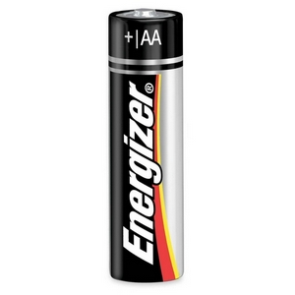
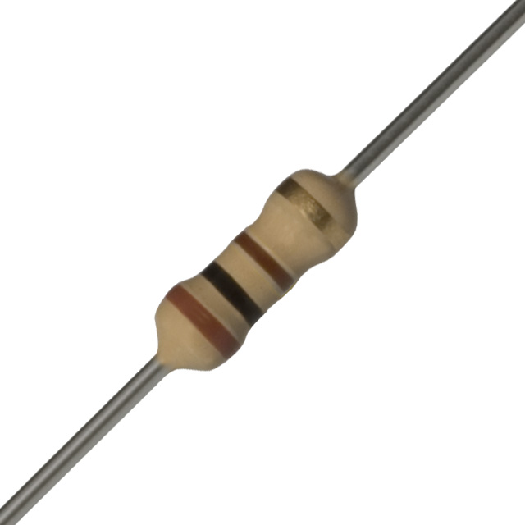
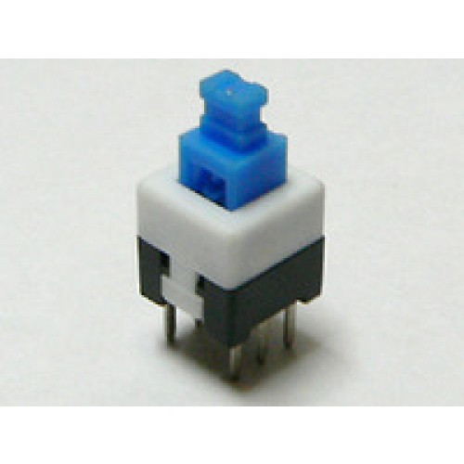
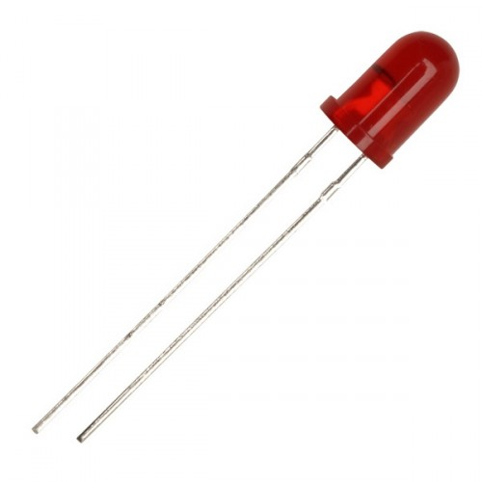
What do you need?
Wires
1 Red
1 Black
Breadboard
Battery Holder
2 AA Batteries
Brown Ring
Black Ring
Brown Ring
Red L-E-D
Resistor (100 ohms)
Push to On
Switch
Latch

Slide 11
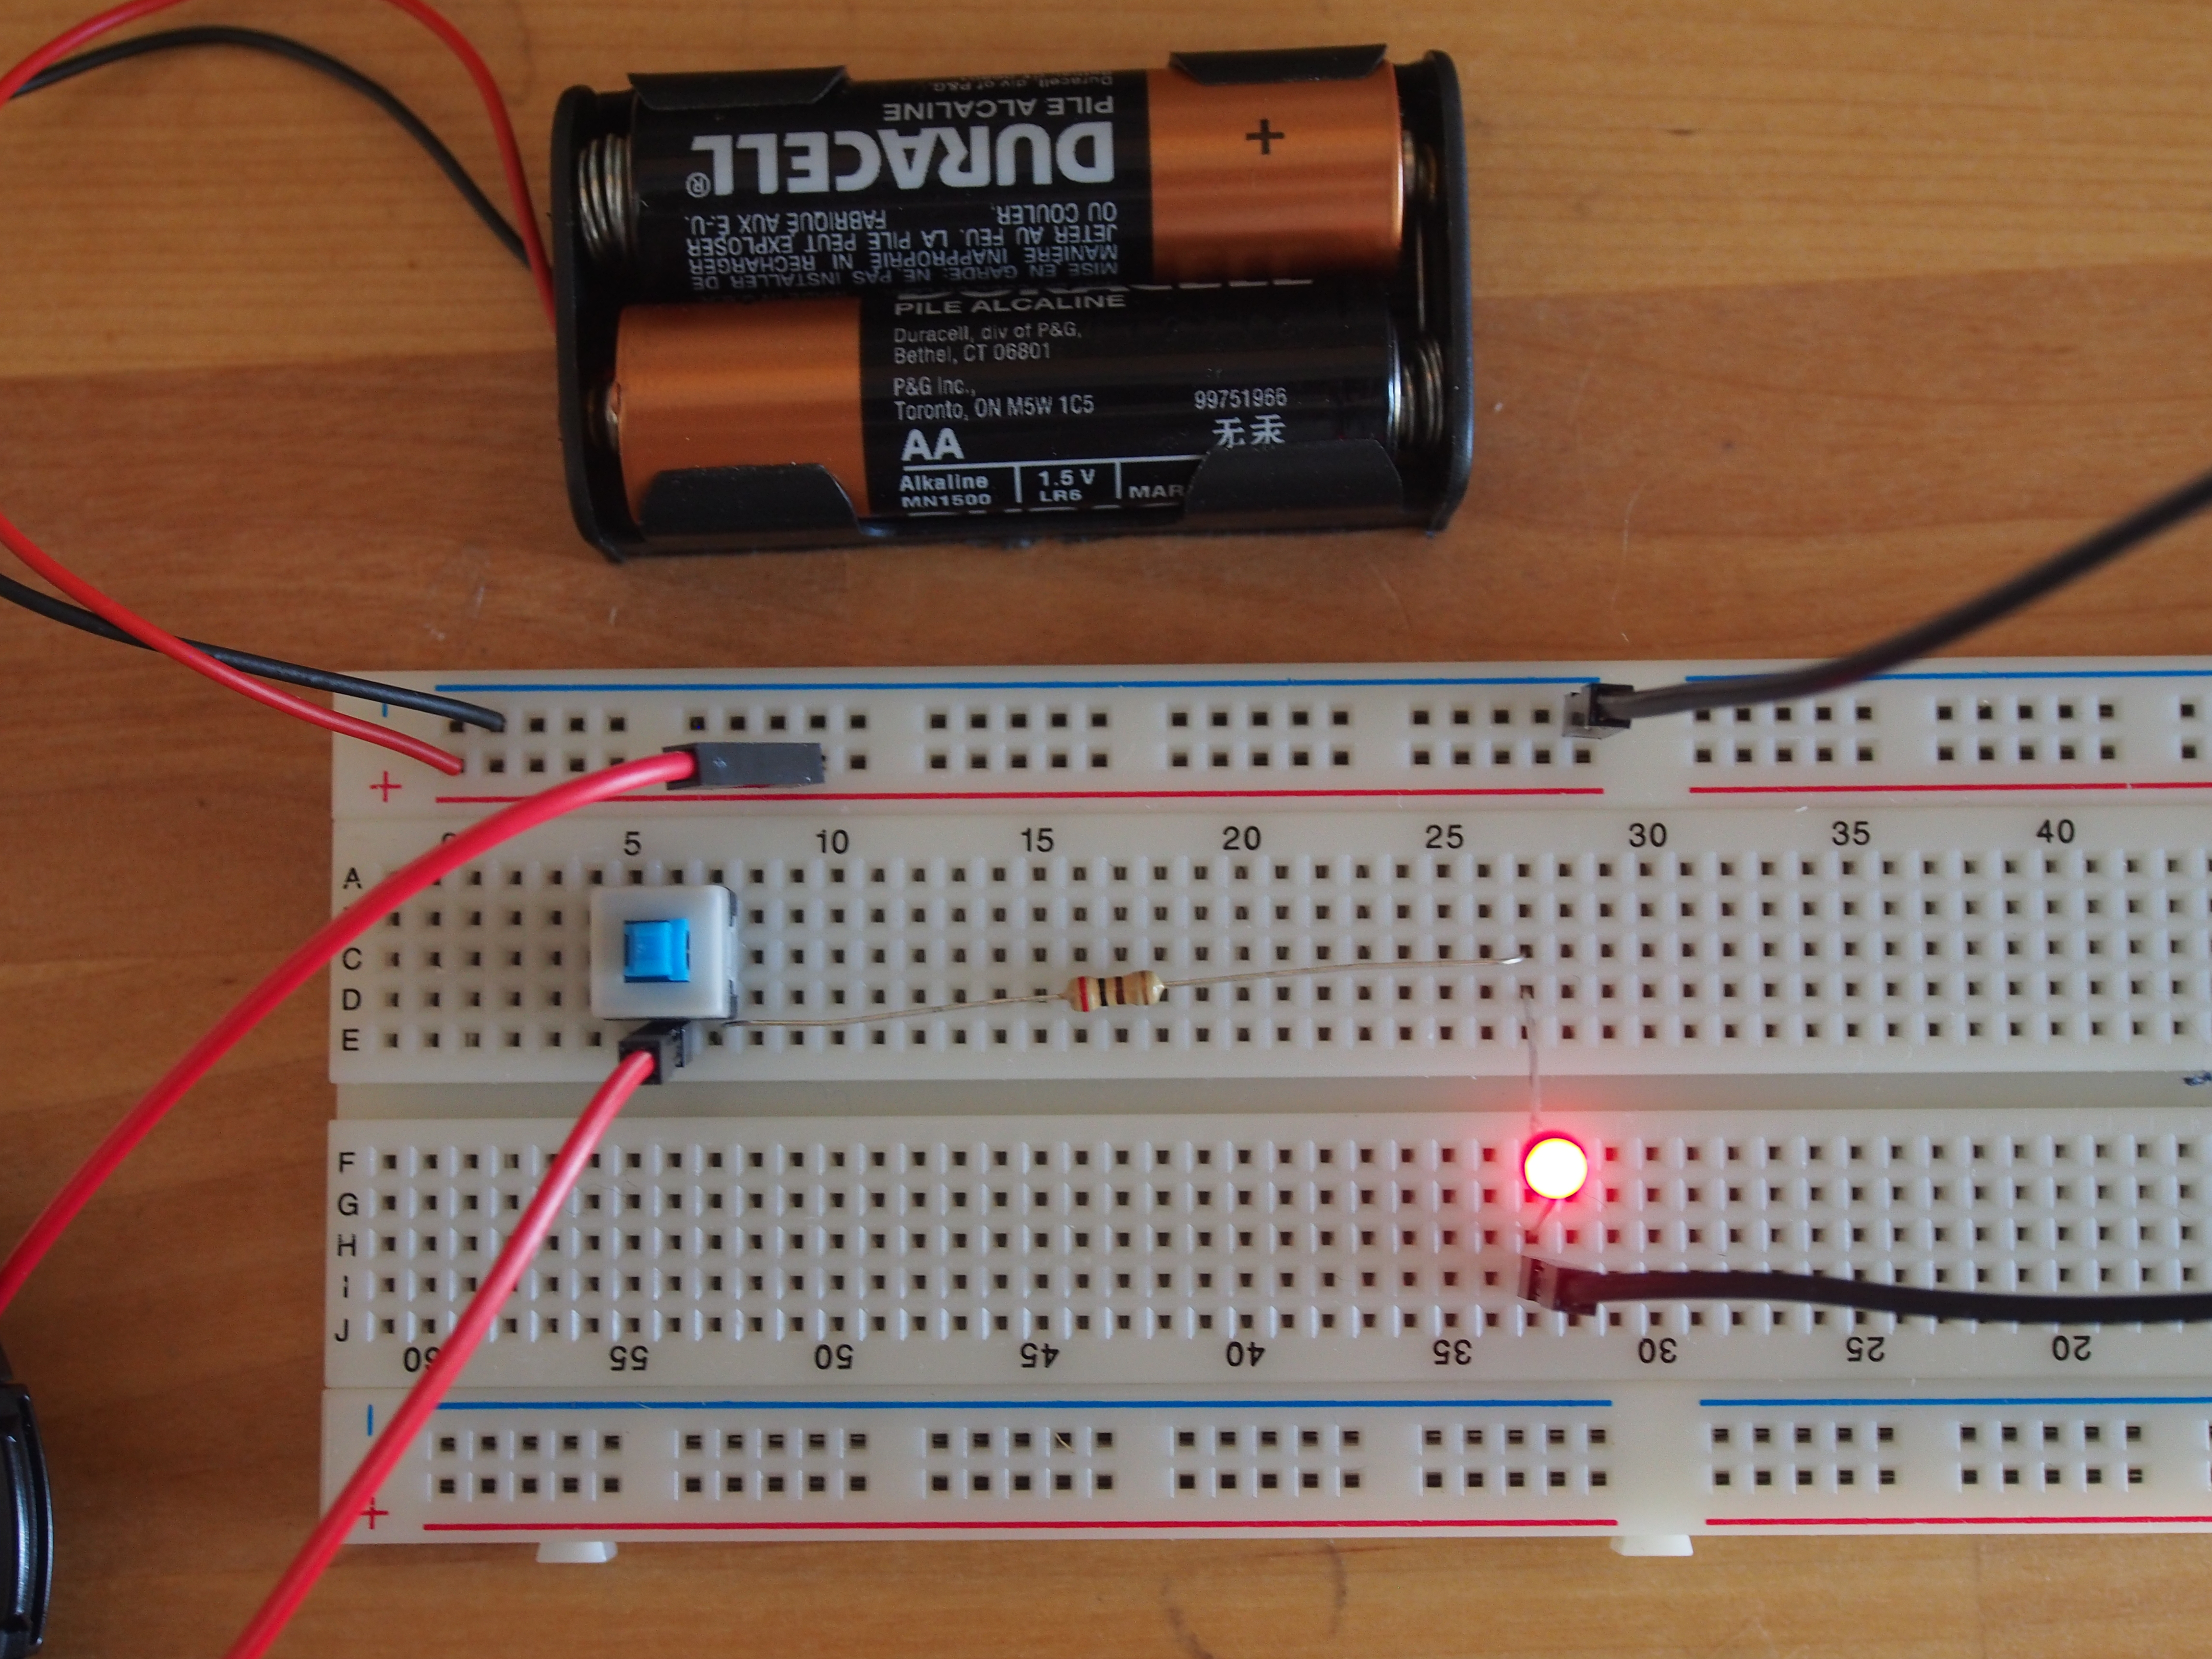
Go build !
Let’s Build !
Long leg

Slide 12
Did it work?

Slide 13
Did you try with the other type of switch?
What is the difference?

Slide 14
Electricity
Atom and sub-atomic particles
Electrons (negatively or –ve charged)
Protons (positively or +ve charged )
Electric charge
Electric force
Electricity
Animations to check out: http://scratch.mit.edu/users/Devoxx4Kids-USA/
Notes:
http://scratch.mit.edu/users/Devoxx4Kids-USA/
Battery Sketches
Electric charge is the physical property of matter that causes it to experience a force when close to other electrically charged matter. There are two types of electric charges – positive and negative. Positively charged substances are repelled from other positively charged substances, but attracted to negatively charged substances; negatively charged substances are repelled from negative and attracted to positive. An object will be negatively charged if it has an excess of electrons, and will otherwise be positively charged or uncharged.
Electricity is the set of physical phenomena associated with the presence and flow of electric charge. Electricity gives a wide variety of well-known effects, such as lightning, static electricity, electromagnetic induction and electrical current. In addition, electricity permits the creation and reception of electromagnetic radiation such as radio waves.

Slide 15

How does it work?
Pressed
Pressed
Water flow
Electric
Current
Light
Glows!

Slide 16
What does switch do?
Released
Button
Released
No current
No light!

Slide 17
Why do we need the resistor?
Pressed
Reduced
Water flow
Lower Electric
Current

Slide 18
Electric push (Voltage)
> Voltage is the push for the charge to flow
> Voltage is measured in Volts
> Volts is shown as ‘V’ in diagrams

Slide 19
Electric Current
> Current is the flow of electric charge
> Current is measured in Ampere
> Ampere is shown as Amp or A in diagrams
> Smaller unit of current is milli Ampere (or mA).
> 1000 milli Ampere = 1 Ampere

Slide 20
Resistance
> Resistance is the opposition to the passage of electric current
> Resistance is measured in Ohms.
> Resistance is shown as Ohms or Ω
in diagrams. Larger resistances are shown as “Kilo” or “Mega”

Slide 21
Let us meet the components ….

Slide 22
I am battery
> I push the electrons or “electric charge” in the circuit
> Each battery provides a push for electrons to
flow.
> The push is also called Voltage and is measured in Volts.
> Each AA Battery provides 1.5 Volts of push.
> Two batteries pushing after one another
create a push of 3.0 volts
Notes:
Low voltage
Never play with the main outlets

Slide 23
I am L-E-D
> An LED is a very small light, often colored (white / red / yellow / green)
> Each LED has two legs ... a short and a long
> Long is the PLUS (+) (positive pole)
> It glows when current flows
> It can handle only small amount of current
> Short ... MINUS (-) (Negative pole)

Slide 24
I am resistor
Black (0)
Ring
Brown (1)
Ring
Brown (1)
Ring
> I offer resistance to the flow of current
> The amount of resistance I offer is fixed.
> The amount of resistance I offer is measured in Ohms. Sometimes people prefer to use Kilo and Mega Ohms to keep the numbers small and easily readable
> The amount of resistance I offer is identified by the colors of the rings on me.
1 0 0 Ohms
Resistor (100 ohms)
Notes:
Try the scratch

Slide 25
How much is my resistance?
A
Second Digit
B
First Digit
Multiplier
C
Tolerance
D

Slide 26
I am “Push for On” switch
> I let current pass when you press me.
> I do not let any current to flow when I am left alone.

Slide 27
I am Push Button Latch
> Press me to close the circuit (“On”)
> Press again to open the circuit
(“Off”)

Slide 28
I am wire
> I am the pipe thru which electrons flow from one component to another.
> I do not change the flow/ offer resistance.
> What ever voltage is one end, it gets transferred to the other end.
> Color of the insulation does not change what I do!
> Color can help identifying what signal I have, if you follow convention. For example, red color in usually the +ve voltage while black is Ground.

Slide 29
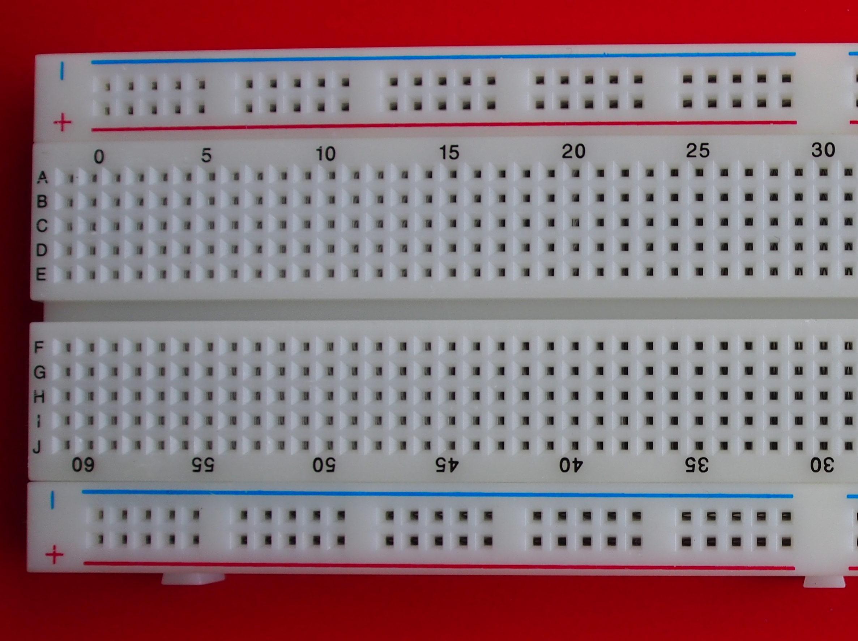
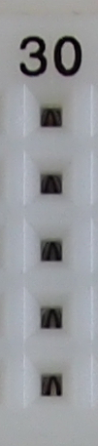
I am Breadboard

Slide 30
Go build !
Under the breadboard hood
Long leg

Slide 31
The circuit diagram
10 milli Ampere
100 Ω
3.0 Volt
… in the language of the engineers !

Slide 32
The circuit diagram
10 milli Ampere
100 Ω
3.0 Volt
… in the language of the engineers !

Slide 33

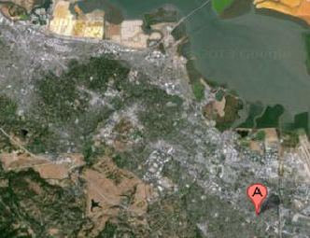
Which picture will you use to help a friend drive from Redwood City to Mountain View?

Slide 34
Activity #2
Build a light with a Dimmer
Notes:
00:40

Slide 35
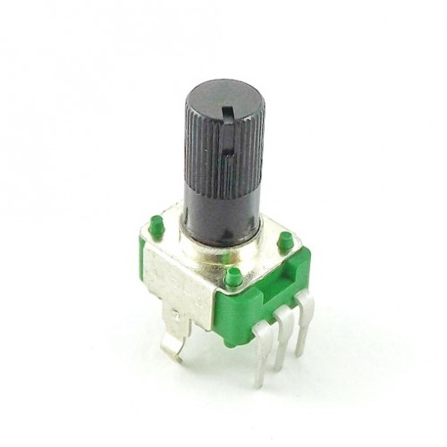
What do you need?
Wires
1 Red
1 Black
Breadboard
Battery Holder
2 AA Batteries
Brown Ring
Black Ring
Brown Ring
Red L-E-D
Resistor (100 ohms)
10 Kilo Ohm variable resistor
Aka Potentiometer

Slide 36
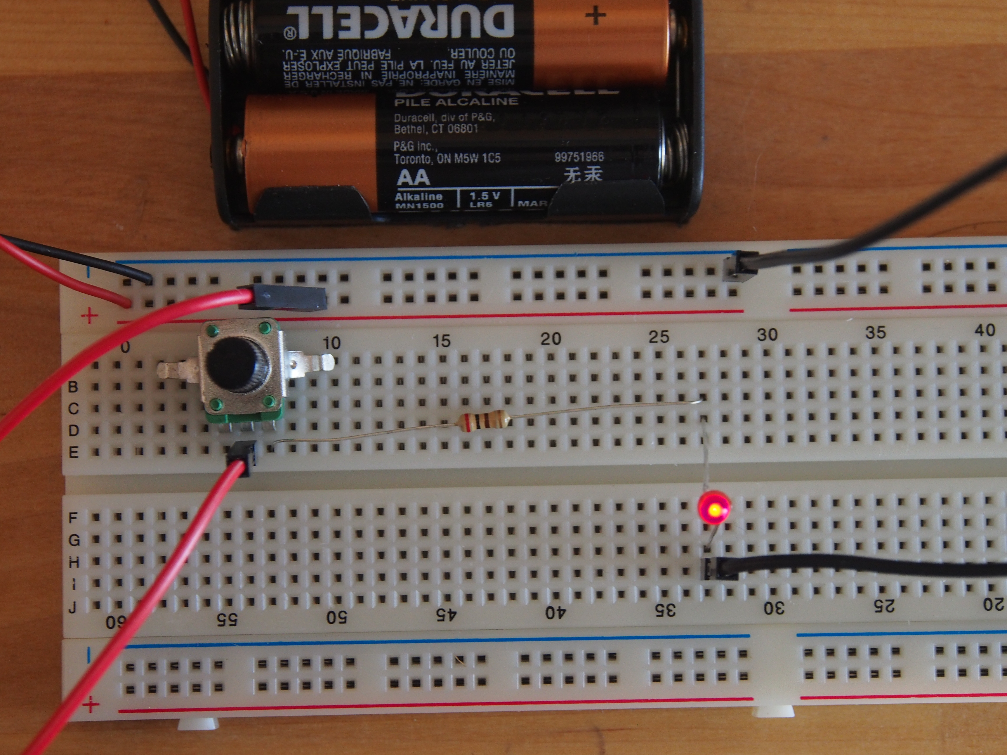
Let’s build ..…
Long leg

Slide 37
Did it work?

Slide 38
Let us meet the components ….

Slide 39
I am the variable resistor
> Resistance between the middle terminal and either of the two end terminal depends upon where the know is turned.
> The amount of resistance is somewhere in between fixed resistance and zero.
> I offer fixed resistance between the two end terminals.
> I have three terminals

Slide 40
The circuit diagram
100 Ω
10 K Ω
3 Volt
… in the language of the engineers !

Slide 41
How does it work?

Slide 42
Ohm’s Law
If we increase the resistance in the circuit, less current will flow thru it.
Provided we do not change the voltage ( push).
Notes:
Check out the scratch

Slide 43
Ohm’s Law
If we increase the push(voltage) applied to the circuit, more current will flow thru the circuit
Provided we do not change the resistance

Slide 44
Ohm’s Law
Voltage drop across a component is the amount of current flowing through it and multiplied by the resistance offered by it.
V = I * R

Slide 45
What do we use Ohm’s law for?
> LED manufacturer says: “This LED may be damaged if current above 10 milli Amps flows thru it. The voltage across the red LED will be 2 volts when it is glowing.”

Slide 46
Please remove the batteries
Why?

Slide 47
Activity #3
Blinking LED using Arduino
Notes:
00:55
Stretch

Slide 48
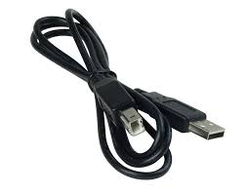
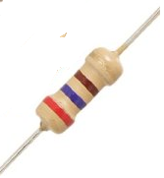

What do you need?
Arduino
Breadboard
Brown Ring
Violet Ring
Red Ring
USB cable
Wires
1 Red
1 Black
Red L-E-D
Resistor (270 ohms)
Laptop

Slide 49
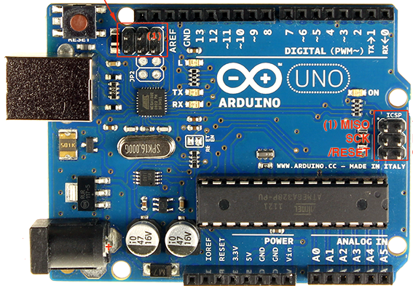
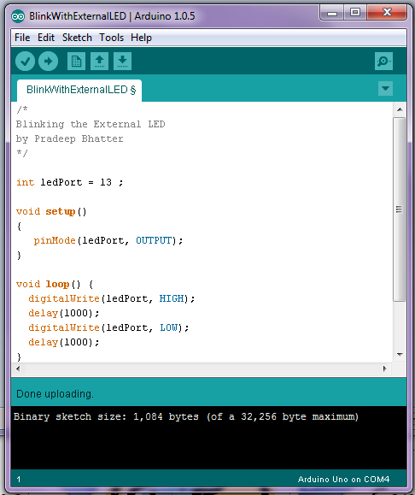



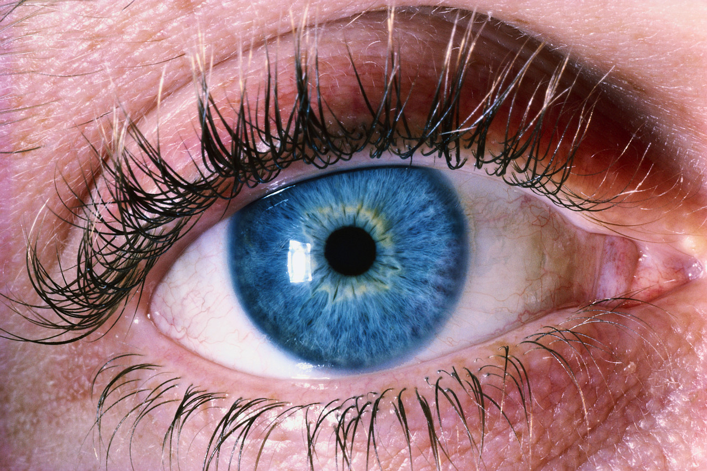
How does it work?
Instructions
Input
ports
Output
ports
Sensing
Controlling

Slide 50
Digital Output Port
Device (our LED circuit) is connected to the port
Arduino generates signal on the port
The device receives the signal and acts
Example: Signal on the port is set to 5 Volts to “Power-On” the LED
5 Volts
Start
0 Volts
Wait
1 second
Wait
1 second
Wait
1 second
Wait
1 second
Turn
On
Turn
Off
Turn
On
Turn
Off
Turn
On

Slide 51
Let’s meet the components ….
Port 13
USB
Port
GND (Ground)

Slide 52
The circuit diagram
9 milli Ampere
270 Ω
13
Arduino
GND
… in the language of the engineers !

Slide 53
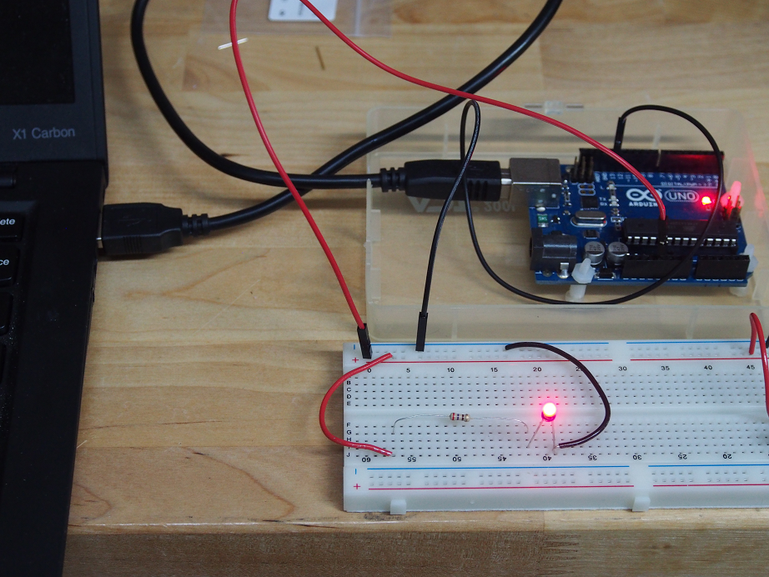
Connect – ve of Board To GND on Arduino
Let’s build!
Connect USB cable
Connect +ve of Board to Port 13 on Arduino
Long leg

Slide 54
Time to write a “Sketch”

Slide 55
Did you download and install the software successfully? If not …
Go http://arduino.cc/en/Main/Software
Download the software appropriate for your computer
Windows 7
Windows 8
Mac
Linux
Install the software on you computer
64 bit Windows – manually install Driver using Device Manager.

Slide 56
Install the driver (Windows only)
Open Windows explorer and navigate to “Computer” and right click on it.
Select “Properties”
Click on “Device Manager”
Look under Ports (COM & LPT). Mostly likely you will find the Arduino as COM3 or COM4.
Right click and choose to “Update Driver Software”
Select “Browse my computer for software driver”
Select the appropriate driver from the “drivers” directory of the Arduino software you had downloaded. (e.g. ….arduino\arduino-1.0.5\drivers )

Slide 57
Is Arduino connected the computer?
Time to get them talking ….

Slide 58
Outline of the Sketch: Please Arduino ….
Use Port 13 for output
Set Port 13 voltage = 5 Volts (Glow the LED)
Wait for 1 second
Set Port 13 voltage = 0 Volt (Switch-off LED)
Wait for 1 second
Keep repeating the Steps 2 to 4 forever

Slide 59
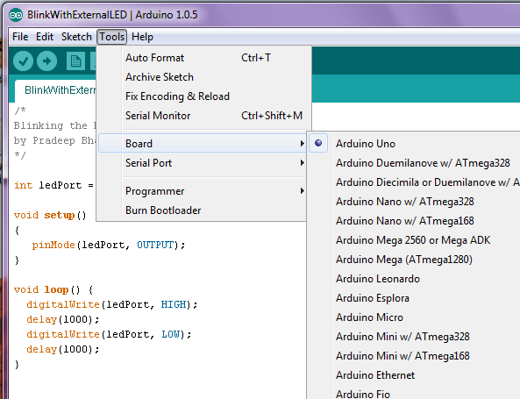
Select Board “Arduino Uno”

Slide 60
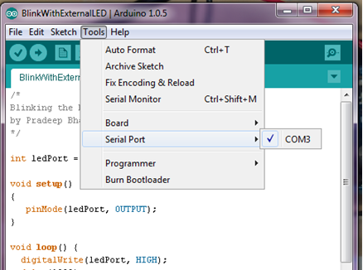
Select the Communication Port (Windows)

Slide 61
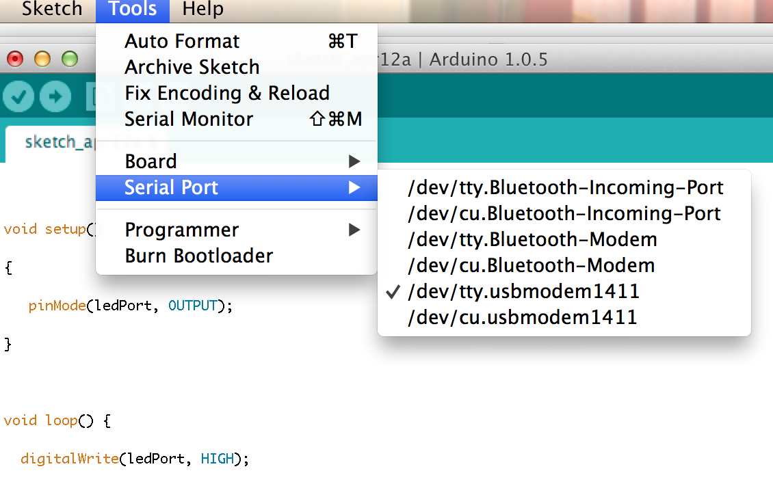
Select the Communication Port (Mac)

Slide 62
Write the Sketch
Click on Upload to send the instructions from the computer to Arduino
Verify instructions were
Uploaded!!
And there were no errors
........

Slide 63
Sketch
int ledPort = 13 ;
void setup()
{
pinMode(ledPort, OUTPUT);
}
void loop() {
digitalWrite(ledPort, HIGH);
delay(1000);
digitalWrite(ledPort, LOW);
delay(1000);
}
Notes:
Setup – called one time
INPUT or OUTPUT
Loop – continuously repeated
HIGH – 5V
LOW – 0V
Why do we use ledPort?
Why do we use Camel Case?

Slide 64
Did it work?

Slide 65
Talking to the world
Input Port
Output Port
Off
Off
On
On

Slide 66
Digital Input Port
Signal on the port is measured as either 0 or 1. It can only be one of the two values.
Example
If voltage on the port is 5 V, it is On (Binary 1)
If voltage on the port is 0 V, it is off (Binary 0)

